Slide 1
Mining for Associations in Medical Literature
Data Method Software Findings

Slide 2
Motivation
Fundamental elements of Scientific Paper
Data, Method, Software, Findings
Form central thesis
Connect essential ideas of these 4 types to verify, reproduce and analyze results of medical journal/article
Currently extremely difficult to manually glean this information
Efforts of automatic curation sacrifice accuracy and quality
Machine Learning approach could be a solution

Slide 3
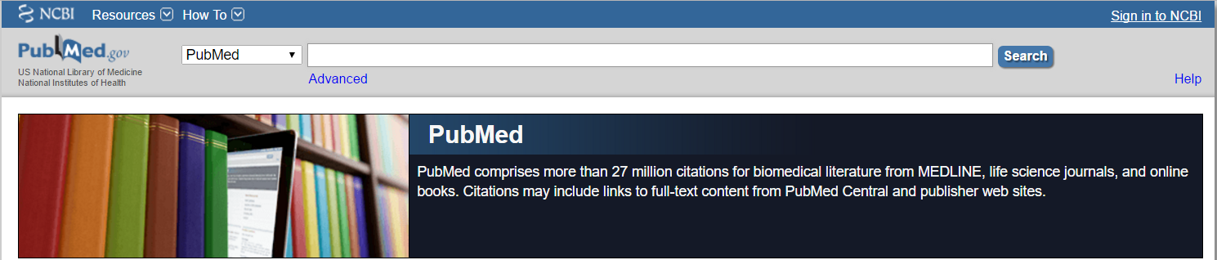
DataSet
Pubmed
Keywords: molecular biology, molecular dynamics and structural biology
Acquire 9-10 thousand papers
Utilize ID to fetch according to keywords

Slide 4
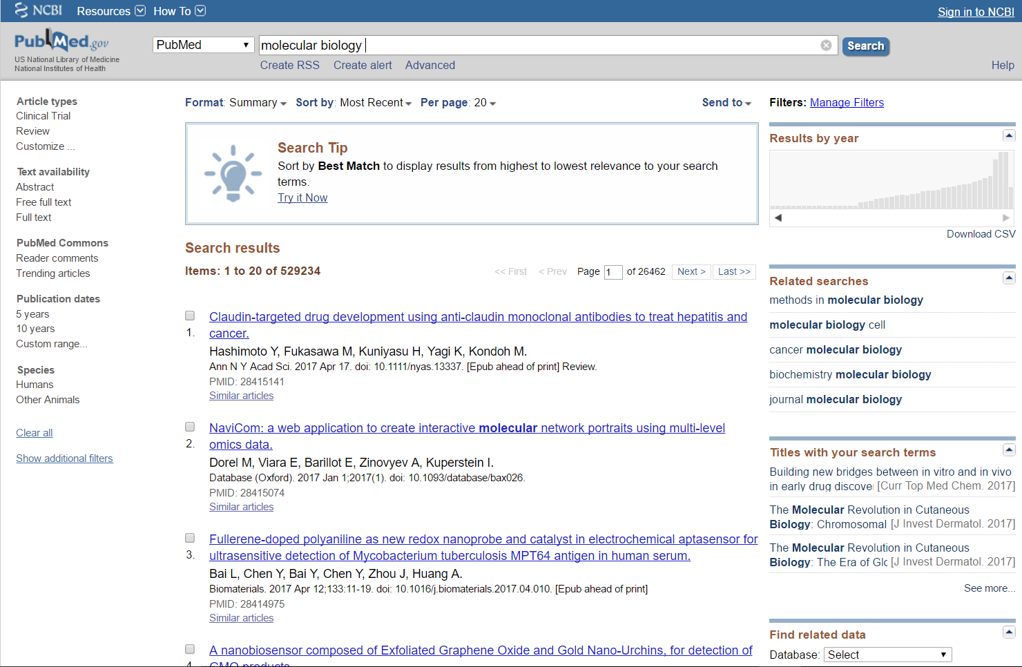
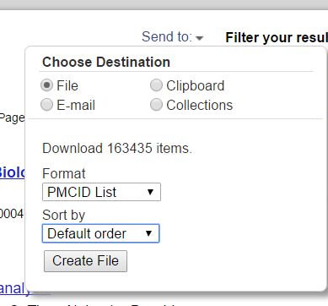

Slide 5
Approach
Acquire Data
Process articles, tokenize sentences for classification
SupervisedNaïve bayes Classifier
Manually create training data
Look at sections/sentences of each scientific paper and assign a DMSF association
Evaluate Model
Accuracy and informative features

Slide 6
Issues
Difficulty acquiring full text
1 in 20
Limited Resources, NCBI confusing/disliked manual
Copyright issue
Open Access Subset
Data pull limits and constraints
100 queries every 3 seconds
Pull outside of peak hours and on weekends
Notes:
Programatically
Majority of articles are not available for bulk download
They ask that you utilize the OA subset, but its much more difficult to parse for specifics

Slide 7
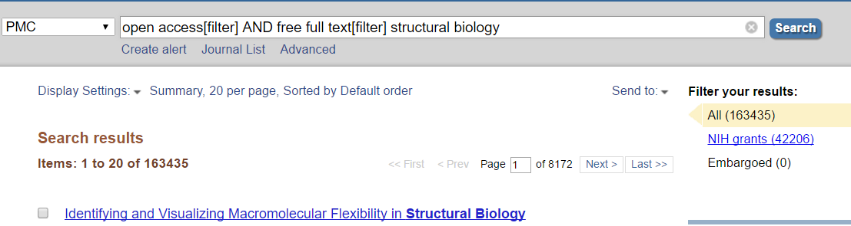
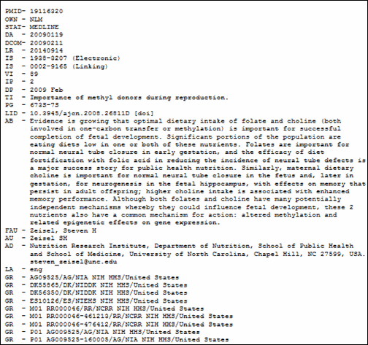
Pulling Data
Utilize Browser Resource to download list of ID
In OA Subset
Containing Full-Text
Relating to Keywords
Biopython
Medline format
Abstract and PMCID to JSON
Notes:
Establish a model using abstracts from paper first, I was still having a hard time acquiring the full text. Abstract was included in the medline format
Biopython- large project with tools for computational molecular biology

Slide 8
Classifier
Manually created labeled training/testing data
90/10 split
‘Finding’ occurs significantly more frequently‘Software’ or ‘Data’ (least frequent)
NLTK
Features (nltk.classify.util.apply_features)
Accuracy (nltk.classify.util.accuracy)
92.6%
Spot check- not as pleasing, ‘Finding’ seemed to be default classification of the model wasn’t sure
Notes:
Training data about 200, 90/10 split
Natural language toolkit. Python work with the human language
Features- decides whats relevant
Example: for determining gender based on name you can look at the last later of the name. vowels, h, n more common for females
Extract relevant info for feature info
How often a certain word occurs for a certain type
Test/training data too clearly a certain type.

Slide 9
Model.show_most_informative_features
Most Informative features
contains(that) = True Findin : Softwa = 9.8 : 1.0 contains(analysis) = True Softwa : Findin = 8.8 : 1.0 contains(results) = True Findin : Softwa = 7.0 : 1.0 contains(measured) = True Method : Softwa = 4.9 : 1.0 contains(showed) = True Data : Softwa = 4.9 : 1.0 contains(program) = True Softwa : Findin = 4.2 : 1.0 contains(These) = True Findin : Data = 4.1 : 1.0 contains(after) = True Method : Softwa = 3.8 : 1.0 contains(animals) = True Data : Method = 3.5 : 1.0 contains(performed) = True Softwa : Findin = 3.2 : 1.0 contains(based) = True Softwa : Findin = 3.2 : 1.0 contains(method) = True Softwa : Findin = 3.2 : 1.0 contains(counted) = True Method : Softwa = 2.7 : 1.0 contains(compared) = True Method : Softwa = 2.7 : 1.0 contains(Using) = True Method : Softwa = 2.7 : 1.0 contains(found) = True Findin : Softwa = 2.6 : 1.0
Notes:
Which features were most effective for distinguishing a sentences type
Software- analysis, program, method
Findings- that, measured, these, found
Method- measured, after, countd, compared
Data- showed, animals
Method occurs 3 times as often in software type than finding type

Slide 10
Future Work
Improve classifier
Increase count of manual training data
Change algorithm/technique (SVM, bag of words, recurrent neural networks)
Incorporate confidence into predictors
Apply model to full text
Increase training dataset using full text data
Incorporate placement, section, paragraph title into analysis
Utilize classifications to perform summary analysis

Slide 11
Full Text
Downloaded all 10000 full texts as XML
Lack standardization for parsing
Tricky to breakdown like the abstract for input into the model

Slide 12
